Slide 1
Agenda | Monday, 5/2/22
Any Question?
Project 5
Invalid Morse Code
Project 6
Final Exam
Not in Classroom Next Monday, 5/9/22
Course Evaluations
Huffman Coding

Slide 2
Huffman Coding
Module 22

Slide 3
Additional Videos
Huffman Code
https://www.youtube.com/watch?v=iiGZ947Tcck
** | https://www.youtube.com/watch?v=IuFKDrdmgIQ
https://www.youtube.com/watch?v=OtDxDvCpPL4
https://www.youtube.com/watch?v=JsTptu56GM8
Harvard | Advanced Algorithms
https://www.youtube.com/watch?v=edOWKZE1t84&list=PL2SOU6wwxB0uP4rJgf5ayhHWgw7akUWSf&index=4

Slide 4
Huffman Coding
“This is an example of a Huffman tree”
Compression algorithm
What’s the file size, if the info is saved in a file?
Can we do better?
Notes:
Hello.txt

Slide 5
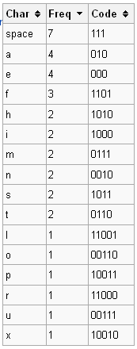
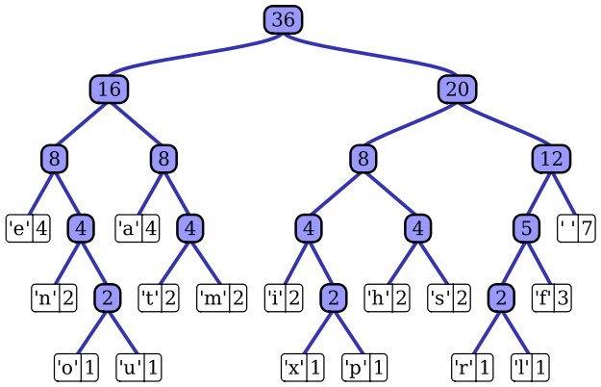
Huffman Coding
Huffman coding is an entropy encoding algorithm used for lossless data compression
Use of a variable-length code table for encoding a source symbol (such as a character in a file) where the variable-length code table has been derived in a particular way based on the estimated probability of occurrence for each possible value of the source symbol
Uses a priority queue based on frequency
Notes:
this is an example of a huffman tree

Slide 6
Huffman Tree – how to build
Compute the frequency of each character in the text (file) you wish to encode
Allows you to determine which characters should have the fewest bits, etc
Build a “coding tree” from the bottom up according to the frequencies
Suppose we only want to encode the five letters (a, b, c, d, e) and they have frequencies 3, 3, 1, 1, and 2, respectively
Create a leaf node for each character/frequency pair and put them into a priority queue, so that the characters with lower frequencies appear first:
1
‘c’
1
‘d’
2
‘e’
3
‘a’
3
‘b’

Slide 7
Huffman Tree – how to build
Now we pick the two nodes with the smallest frequencies (the two at the front of the priority queue) and create a new node with those two nodes as children (the first value from the queue becomes the left, the second value from the queue becomes the right). We assign this new branch node a frequency that is the sum of the frequencies of the two children. This new node is then put back into the priority queue:
2
‘e’
2
-
3
‘a’
3
‘b’
1
‘c’
1
‘d’

Slide 8
Huffman Tree – how to build
Continuing in this way, we build up larger and larger subtrees.
3
‘a’
3
‘b’
4
-
2
‘e’
2
-
1
‘c’
1
‘d’
4
-
6
-
2
‘e’
2
-
3
‘a’
3
‘b’
1
‘c’
1
‘d’

Slide 9
Huffman Tree – how to build
And finally
char | freq | code
b | 3 | 11
a | 3 | 10
e | 2 | 00
d | 1 | 011
c | 1 | 010
10
-
4
-
6
-
2
‘e’
2
-
3
‘a’
3
‘b’
1
‘c’
1
‘d’
The Huffman code is derived from this coding tree simply by assigning a zero to each left branch and a one to each right branch. The code can be read directly from the tree. The code for a is 10, the code for b is 11, the code for c is 010, the code for d is 011 and the code for e is 00.

Slide 10
Huffman Tree – how to use
char | freq | code
b | 3 | 11
a | 3 | 10
e | 2 | 00
d | 1 | 011
c | 1 | 010
-
-
-
2
‘e’
-
3
‘a’
3
‘b’
1
‘c’
1
‘d’
Given the following code sequence, figure out the text:
1011001011011000101110
Traverse the tree until find a leaf – put character in queue
Answer: abeabdecba
Notes:
How is this better?
3x2 + 3x2 + 2x2 + 3 + 3 = 6 + 6 + 4 + 3 + 3 = 22 bits = ~3 bytes
3 vs. 36 bytes
10 + 11 + 00 + 10 + 11 +011 + 00 + 010 + 11 + 10
a + b + e + a + b + d + e + c + a

Slide 11
Activity
Compute the frequency of each character
Example: for the string “better tree”
freq_{b}=1, freq_{e}=4, freq_{t}=3, freq_{r}=2, freq_{Space}=1
Build a “coding tree”
Insert characters into a priority queue, lower-frequency first
Example: consider each character as a node with char & freq
b | 1
Sp | 1
r | 2
t | 3
e | 4
Remove first two characters (ie, two with lowest frequency)
Create a new node, with these two characters as children; new node has a “freq” of the combined frequency of the two children
Insert new node in priority queue in correct position
Example:
Repeat until there is a single tree
r | 2
- | 2
t | 3
e |4
b | 1
Sp| 1

Slide 12
Activity | Huffman Tree
Repeat until there is a single tree
t | 3
e |4
- |4
r | 2
- | 2
b | 1
Sp| 1
- |4
- |7
r | 2
- | 2
t | 3
e |4
- |11
b | 1
Sp| 1
- |4
- |7
r | 2
- | 2
t | 3
e |4
b | 1
Sp| 1

Slide 13
Activity | Huffman Tree
Now code each character by its position in the tree:
Start at the root
Left branch gets a 0
Right branch gets a 1
- |11
char | freq | code
e | 4 | 11
t | 2 | 10
r | 1 | 00
Space | 1 | 011
b | 1 | 010
0 1
00 01 10 11
010 011
- |4
- |7
r | 2
- | 2
t | 3
e |4
b | 1
Sp| 1
Finally build a string: for “beet reet”– 01011111001100111110
NOTE: each code is unique, i.e., you can decode left-to-right.
Example: Decode - 01011111001100111110
010
b
11
e
11
e
10
t
011
__
00
r
11
e
11
e
10
t

Slide 14
Huffman Trees – English Alphabet
A Huffman Tree built from the typical frequency of the letters in the English alphabet looks like this:
-
0 1
00 01 10 11
010 001 010 011 100 101 110 111
0010 0011 0100
0101 0110 0111 1010 1011 1100 1101 1110 1111
00100 00101 00110 00111 01000 01001 11000 11001 11100 11111
001110 001111 110000 110001 111000 111001
0011110 0011111
00111100 00111101
001111000 001111001 001111010 001111011
-
-
-
-
-
-
t
-
-
-
e
-
-
-
-
-
-
r
h
s
n
i
-
o
a
-
f
w
m
-
u
c
-
l
-
d
v
-
b
p
y
g
-
k
-
-
See next slide for the coding chart
z
q
x
j

Slide 15
Huffman Trees – English Alphabet
The Huffman coding chart built from the typical frequency of the letters in the English alphabet (https://en.wikipedia.org/wiki/Letter_frequency):
char | freq | code
e | 127 | 100
t | 91 | 010
r | 60 | 0101
h | 61 | 0110
s | 63 | 0111
n | 67 | 1010
i | 70 | 1011
o | 75 | 1101
a | 82 | 1110
f | 22 | 00100
w | 24 | 00101
m | 24 | 00110
u | 28 | 01000
char | freq | code
c | 28 | 01001
l | 40 | 11001
d | 43 | 11111
v | 10 | 001110
b | 15 | 110000
p | 19 | 110001
y | 20 | 111000
g | 20 | 111001
k | 8 | 0011111
z | 1 | 001111000
q | 1 | 001111001
x | 2 | 001111010
j | 2 | 001111011

Slide 16
Other Data Structures
These are for your reference only. Won’t be on the Final
SkipList
Rope
Properties
BitSet
Disjoint Set
Cuckoo Hashing
Quad Edge
Doubly connected edge list (DCEL)

Slide 17
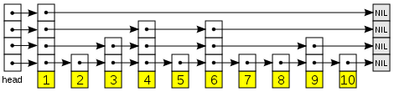
Skip Lists
A skip list is a data structure for storing a sorted list of items using a hierarchy of linked lists that connect increasingly sparse subsequences of the items. These auxiliary lists allow item lookup with efficiency comparable to balanced binary search trees (that is, with number of probes proportional to log n instead of n).
Each link of the sparser lists skips over many items of the full list in one step, hence the structure's name.
Notes:
https://www.youtube.com/watch?v=hqHwQUdTgLM
https://www.youtube.com/watch?v=1G8h3u6Thzs
https://www.youtube.com/watch?v=NDGpsfwAaqo
MIT | https://www.youtube.com/watch?v=2g9OSRKJuzM
https://www.thecrazyprogrammer.com/2014/12/skip-list-data-structure.html

Slide 18
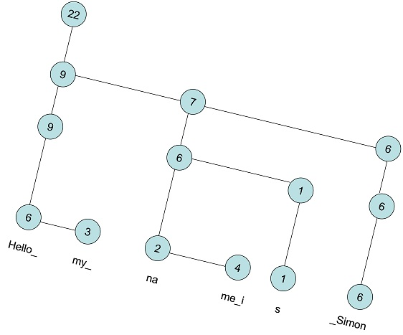
ROPE
A rope, or cord, is a data structure for efficiently storing and manipulating a very long string
Example – a text editing program may use a rope to represent the text being edited, so that operations such as insertion, deletion, and random access can be done efficiently. It is a binary tree
Notes:
https://medium.com/underrated-data-structures-and-algorithms/rope-data-structure-e623d7862137
https://www.geeksforgeeks.org/ropes-data-structure-fast-string-concatenation/
11 minute mark | https://www.youtube.com/watch?v=2oF5dYDIFzc

Slide 19
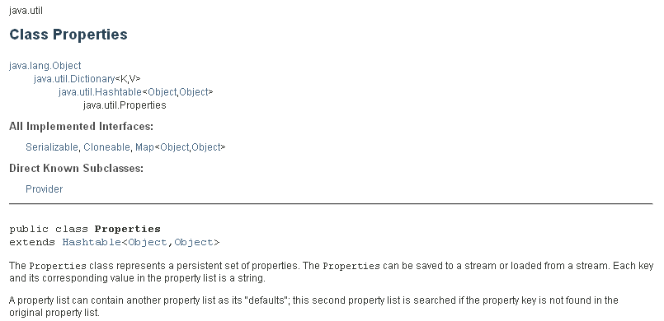
Properties
Properties is a subclass of Hashtable. It is used to maintain lists of values in which the key is a String and the value is also a String
The Properties class is used by many other Java classes. For example, it is the type of object returned by System.getProperties( ) when obtaining environmental values.
Notes:
https://www.baeldung.com/java-properties
https://www.youtube.com/watch?v=X24iwt73c8M

Slide 20
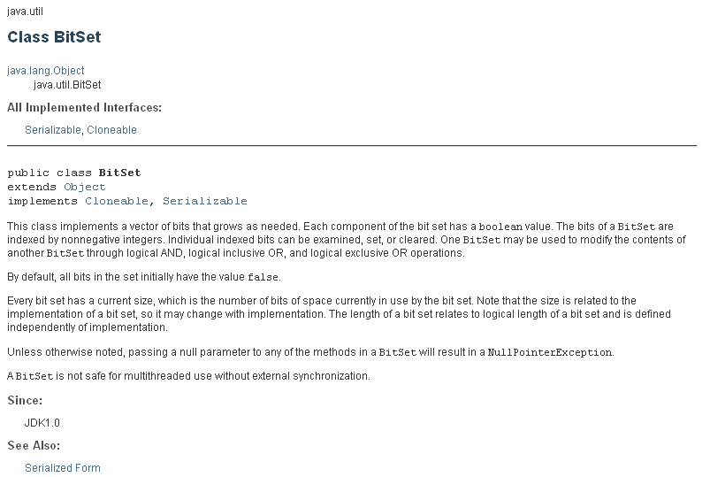
BitSet
A BitSet class creates a special type of array that holds bit values. The BitSet array can increase in size as needed. This makes it similar to a vector of bits.
Notes:
https://www.baeldung.com/java-bitset
https://www.youtube.com/watch?v=x726MRZM758

Slide 21
Disjoint-Set
A disjoint-set data structure is a data structure that keeps track of a set of elements partitioned into a number of disjoint (nonoverlapping) subsets. A union-find algorithm is an algorithm that performs two useful operations on such a data structure:
Find: Determine which subset a particular element is in. This can be used for determining if two elements are in the same subset.
Union: Join two subsets into a single subset.
Because it supports these two operations, a disjoint-set data structure is sometimes called a union-find data structure or merge-find set. The other important operation, MakeSet, which makes a set containing only a given element (a singleton), is generally trivial. With these three operations, many practical partitioning problems can be solved.
Disjoint-set data structures model the partitioning of a set, for example to keep track of the connected components of an undirected graph. This model can then be used to determine whether two vertices belong to the same component, or whether adding an edge between them would result in a cycle.
Notes:
https://www.youtube.com/watch?v=K5gYn7qL3lE&t=0s
https://www.youtube.com/watch?v=ID00PMy0-vE

Slide 22
Cuckoo Hashing
Cuckoo hashing is a scheme for resolving hash collisions of values of hash functions in a hashtable. The name derives from the behavior of some species of cuckoo, where the cuckoo chick pushes the other eggs or young out of the nest when it hatches.
The basic idea is to use two hash functions instead of only one. This provides two possible locations in the hash table for each key. In one of the commonly used variants of the algorithm, the hash table is split into two smaller tables of equal size, and each hash function provides an index into one of these two tables.
The new key is inserted in one of its two possible locations, "kicking out", that is, displacing, any key that might already reside in this location. This displaced key is then inserted in its alternative location, again kicking out any key that might reside there, until a vacant position is found, or the procedure enters an infinite loop. In the latter case, the hash table is rebuilt in-place using new hash functions.
Notes:
https://www.youtube.com/watch?v=-Ubo5GUluGQ
https://www.youtube.com/watch?v=tiYcWJPtcs4
https://www.youtube.com/watch?v=47skwt4njTc
https://www.youtube.com/watch?v=rLMikQTOVnI&list=RDCMUCLv7Gzc3VTO6ggFlXY0sOyw&start_radio=1&t=11
https://www.youtube.com/watch?v=edOWKZE1t84&list=PL2SOU6wwxB0uP4rJgf5ayhHWgw7akUWSf&index=4
Harvard U | 48 min mark

Slide 23
More Data Structures
A quad-edge data structure is a computer representation of the topology of a two-dimensional or three-dimensional map, that is, a graph drawn on a (closed) surface.
The doubly connected edge list (DCEL) is a data structure to represent an embedding of a planar graph in the plane and polytopes in 3D. This data structure provides efficient manipulation of the topological information associated with the objects in question (vertices, edges, faces). It is used in many algorithms of computational geometry to handle polygonal subdivisions of the plane, commonly called planar straight-line graphs (PSLG).
Unions
C style unions allow the same bit pattern to be interpreted in multiple ways. Not available in Java
union
{
char key;
int num;
double volts;
}
This union contains a single member that can be a
char, int or double
Notes:
http://www.neolithicsphere.com/geodesica/doc/quad_edge_overview.htm
http://holmes3d.net/graphics/dcel/

Slide 24
Education – Part of Your Life Journey
The “Big” Picture
Earn your degree
Keep on learning
CS vs. Information Science vs. Information Systems
Value of (College) Education
My Educational Journey
https://www.quora.com/What-were-the-most-popular-programming-language-in-80s-and-90s
Assembly, Pascal, C, FORTRAN
IBM AT & PDP 11
Java, Python, JavaScript, Ada, C++, UI

